Slide 1


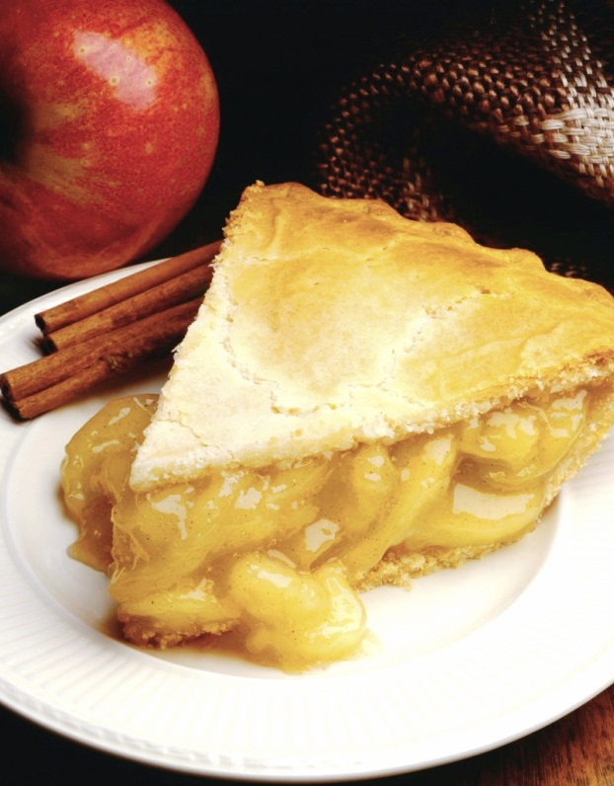
Nutrition Database
Created by Elton Vinh, Joanne Trinh, Gordon Wang, Ethan Huang, Loc Giang, Rama

Slide 2
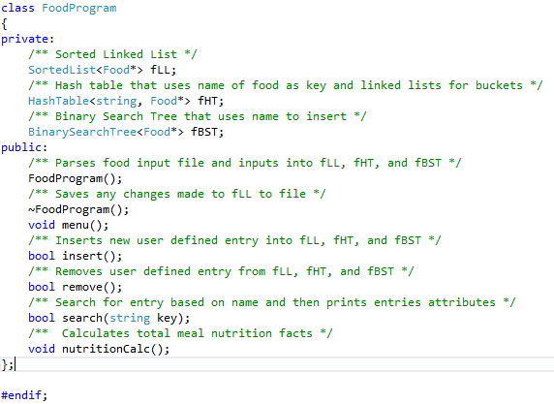
Overview and Features
Food nutrition
Database
Insert
Remove
Search
calculate
HashTable
BST
Sorted Linked List

Slide 3
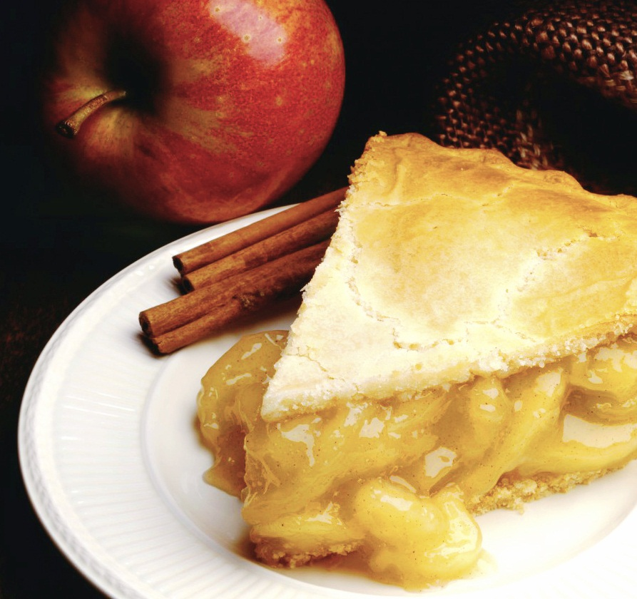
Menu Options
Add new food data
Delete food data
Look up food data
List food data in hash table sequence
List food data sorted by name
Print Indented tree
Print efficiency data of hash table
Food calculator
Quit

Slide 4
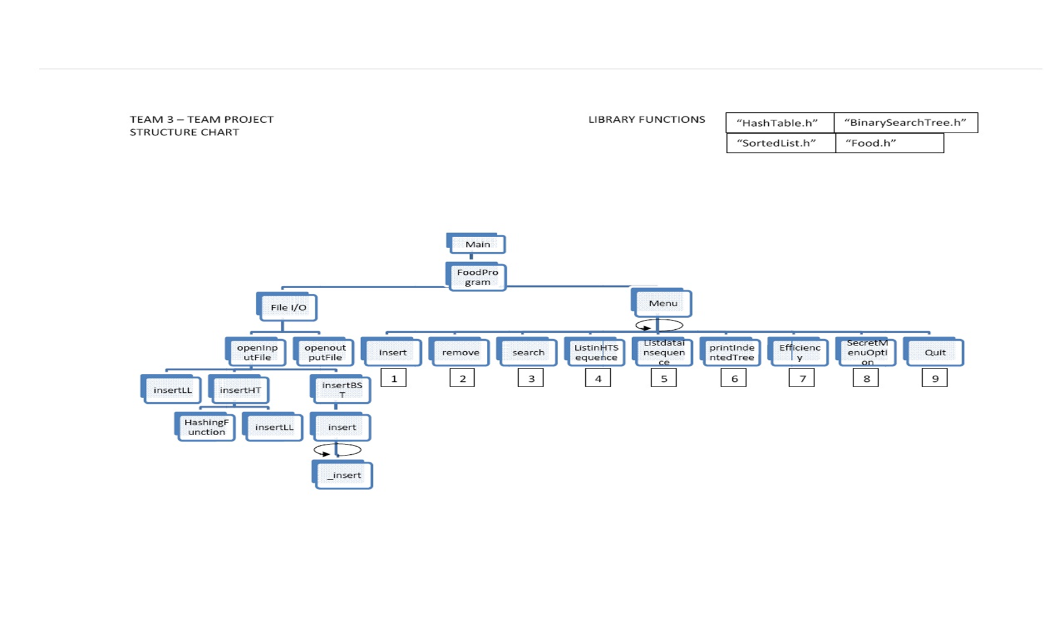

Slide 5
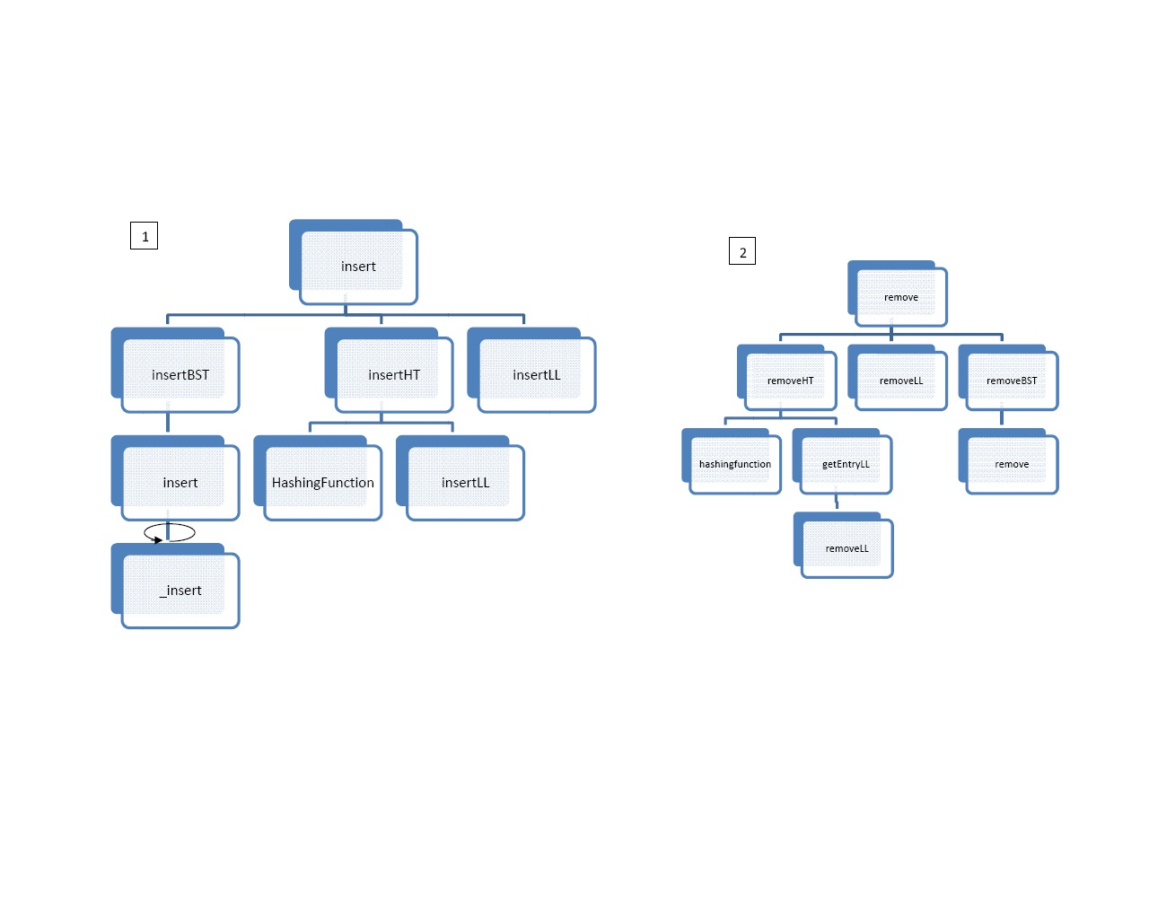
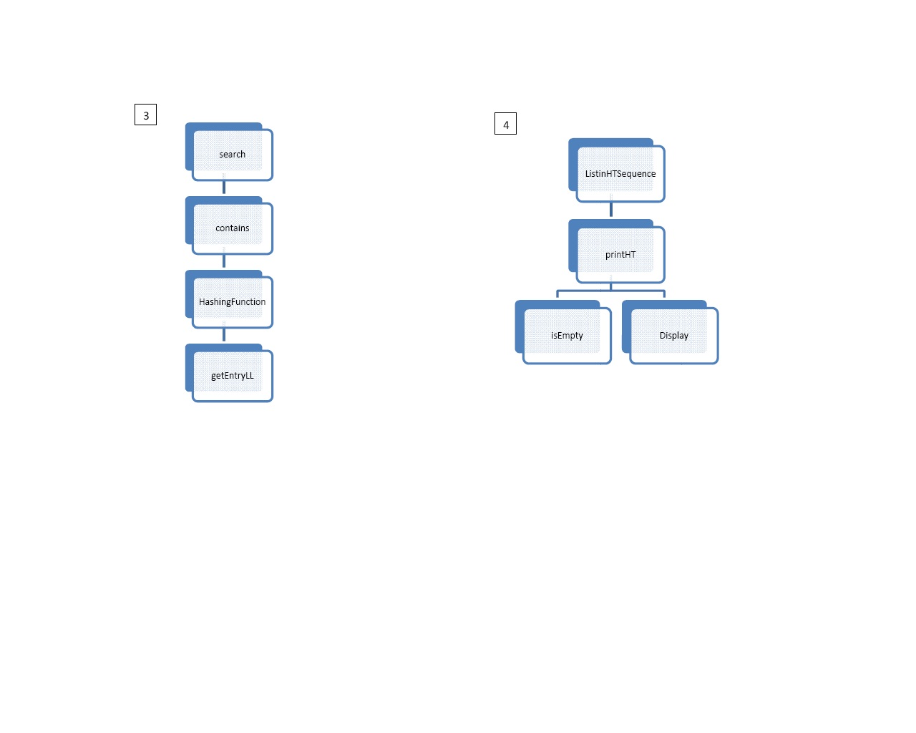

Slide 6
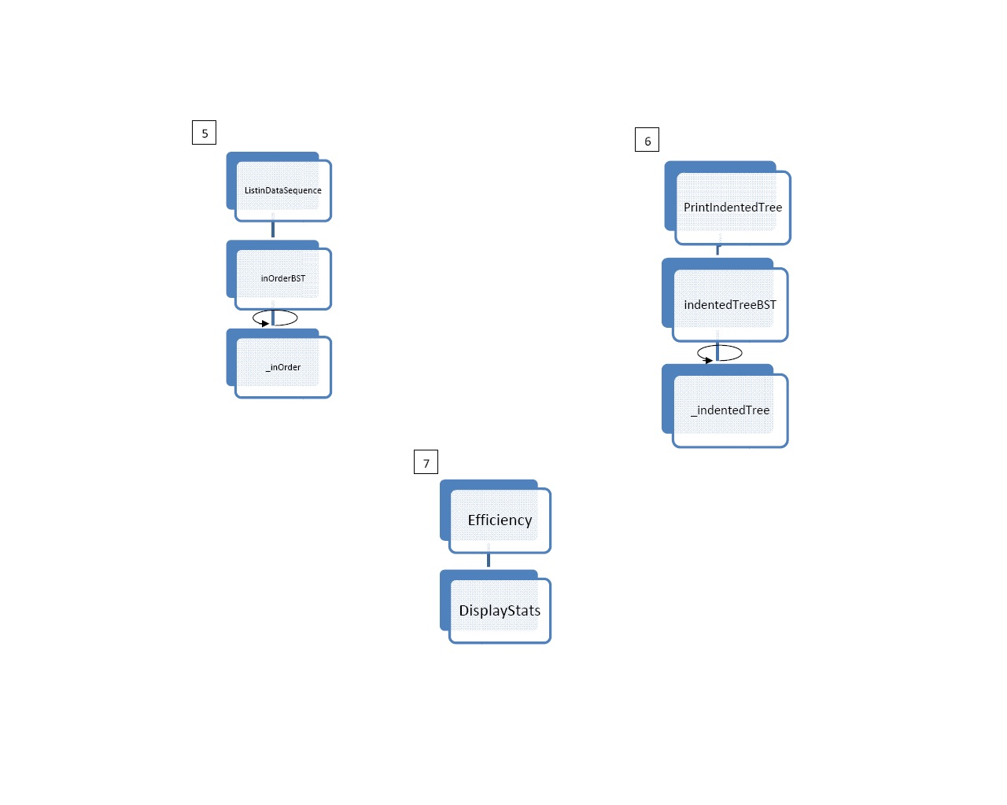
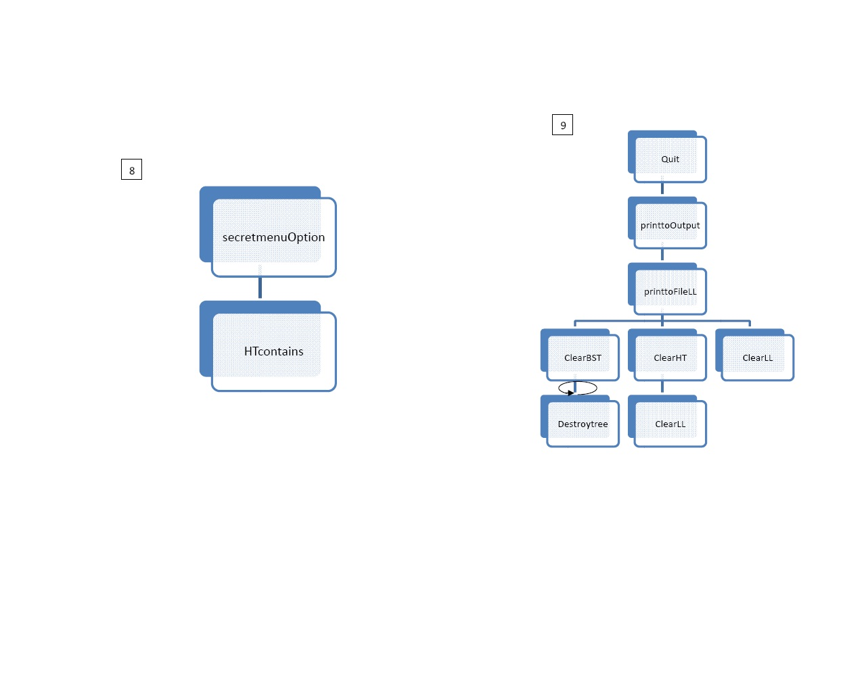

Slide 7

Data Record
Attributes
Name = Tomato
Calories = 15
Total Fat(mg) = 181
Cholesterol(g) = 0
Sodium(mg) = 18
Protein(mg) = 879
Functions
constructors and destructors
getters and setters
overloaded operators

Slide 8
File IO
Name | Calories | Total Fat | Cholesterol | Sodium | Protein
Tomato | 82 | 95
Milk | 76 | 88
Bread | 84 | 90

Slide 9
Data Strutures

Slide 10
Binary Search Tree
Search filters
Print
ascending
descending

Slide 11
Hash Table
Hash Function
Specific look ups

Slide 12

Sorted Linked List
Add your first bullet point here
Add your second bullet point here
Add your third bullet point here

Slide 13
Key Design Efficiencies

